Slide 1
A Brief History and Philosophy of Islamic Algebra
For the University of Oxford

Slide 2
Why History as a Mathematician?
Using history as an attempt to understand our cultural prejudices.
The western perspective.
-We might think of mathematics as a linear process…
-We might think of the development as a concurrent process…
Expect to see links to the past and perhaps more alien elements.
“Why is mathematics important?”
“What is mathematics?”

Slide 3
Modern Mathematical Thought
What are the reasons for mathematics in a society? George W. Heine divides answers to this question into three parts:
Pragmatic reasons
Emphasis on the natural sciences, engineering, economics.
Pedagogical reasons
Useful for training the mind in abstract thought as a prelude for other subjects: logical reasoning.
Aesthetic reasons
Can be pleasurable for the people that work on them: puzzles, games.

Slide 4
What defines algebra?: A Brainstorm
Thinking logically rather than numerically
Arithmetic you reason with numbers, algebra you reason about numbers
Arithmetic involves quantitative reasoning with numbers; algebra involves qualitative reasoning about numbers
A key feature is the introduction and naming of an unknown and logical reasoning to find its value.
Substituting numbers is arithmetic, not algebra
Deriving the formula in the first place is algebra

Slide 5
Stages of Classical Algebra
The conceptual stages of algebra as described by historian Victor J. Katz are as follows:
Geometric stage, where geometric methods are used as the core concepts of algebra. This stage originates with the Babylonians through to the ancient Greeks and was later revived for higher order calculations by Omar Khayýam.
Static equation-solving stage, where the purpose is to find numbers satisfying particular relationships. Algebra did not decisively progress to the static equation-solving stage until al-Khwarizmi introduced generalized algorithmic processes for solving algebraic problems however this divergence from geometric algebra is best attributed to the likes of mathematicians Diophantus and Brahmagupta.
Dynamic function stage, where motion is a core underlying idea. The idea of a function was first proposed by Persian mathematician Sharaf al-D ̄ın al-T ̄us ̄ı (c. 1135-1213), but the lack of explicit functions with symbols meant that algebra did not decisively move to the dynamic function stage until Gottfried Leibniz.

Slide 6
Algebraic Notation
Rhetorical algebra, in which equations are written in verse. First developed by the ancient Babylonians, this era of expression continued up until the 16th century. For example, the rhetorical form ofx+ 2 = 4 is “The thing plus two equals four”. In the later years numbers might have been replaced with the decimal numeral system.
Syncopated algebra, the stage which blends ideas from the rhetorical and symbolic in which some symbolism is used but does not contain all of the characteristics of symbolic algebra. Syncopated algebraic notation first appeared in Diophantus’s Arithmetica (3rd century AD), followed by Brahmagupta’s Brahma Sphuta Siddhanta (7th century). Usually presented with restrictions in the use of core axioms or operations familiar with us today, the understanding of algebraic objects and methods are not in line with that of symbolic algebra.
Symbolic algebra, in which full modern symbolism is used along with the characteristics of abstract algebra. An early concept of this can be found in the work of Islamic mathematician Ibn al-Banna (13th-14th centuries) aptly named Raf al-ij ̄ab, ‘Lifting the Veil’, covering topics such as continued fractions and square roots. This algebraic notion was further developed by Ab ̄u al-Hasan al-Qalas ̄ad ̄ı in the 15th century. Full symbolic algebra was developed by Francois Viete (16th century) and later expanded by Rene Descartes (17th century), introducing the modern notation and linked geometric problems to algebraic expression with Cartesian geometry.

Slide 7
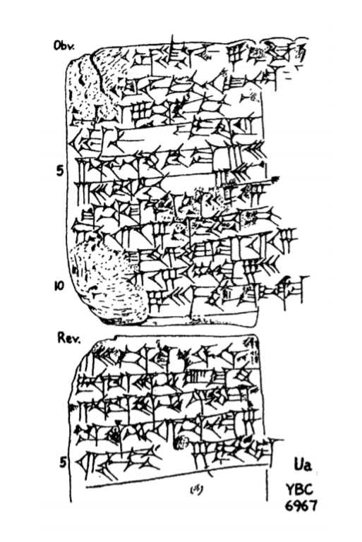
Beginnings of algebraic thinking
Early traces of algebraic thinking in ancient Babylonia ca 2000BCE.
Evidence from cuneiform tablets.
Procedure for solving geometric problems on determining land area and size.
Some problems seemed to have no practical use.
Descriptions were in terms of specific values but made it clear that it applied in general.
Often described as “Babylonian algebra”.

Slide 8
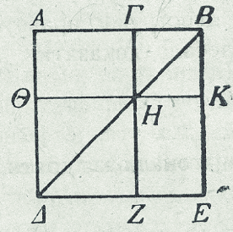
Euclid and his Elements
Most influential mathematical text in the world.
Studied for over 2,500 years.
Translated by a contemporary of al-Khwarizmi, Ibn Yusuf.
Further improved under the reign of al-Ma’amun by al-Rashid.
No explicit reference in al-Khwarizmi’s text.
Geometric examples used as a method of complimenting the algorithms rather than proof.
Truth in Greek Mathematics:
There is no standard of truth, no test nor proof other than tradition.
A step by step guide is given and we as readers assume the truth.
Euclid introduced a new standard with his definitions and axioms.

Slide 9
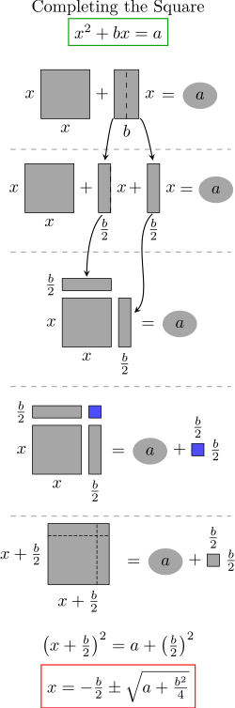
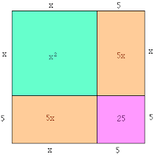
Geometric reasoning: an example
(x + 5)² = x² +10x + 25
Elements can be found in the Nine Chapters of the Mathematical Arts.
Various propositions from Euclid’s Elements.
This symbolism would have been completely alien to the Greeks however and was never used in their work.

Slide 10
Diophantus
Wrote a multi volume (“algebraic”) work, Arithmetica.
Lived in Alexandra between 150 and 250 CE.
First clearly recognisable algebra:
- i.e. introduce an unknown number and reason logically for find its value.
Used letters to denote the unknown.
Used negative numbers.
Solved equations using restoration and confrontation. In modern terms:
Moving a quantity from one side to the other with a change in sign,
Eliminating like terms from both sides.
First translations not made until several decades after al-Khwarizmi’s work.

Slide 11
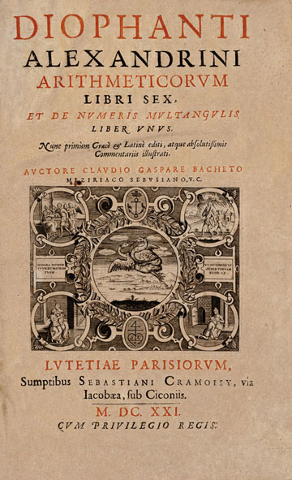
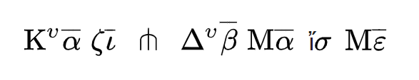

Diophantus: a note on notation
Modern notation
$x^{3}−{2x}^{2}+10x−1=5$
Symbol for symbol translation
${(x}^{3}1+x10)−\left(x^{2}2+x^{0}1\right)=x^{0}5$
Diophantus’s notation

Slide 12
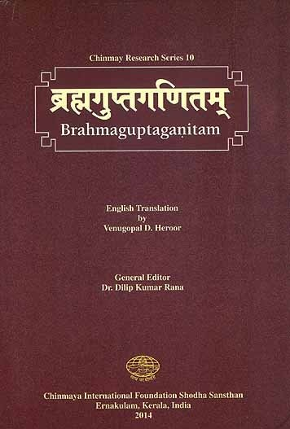
Brahmagupta
628: Wrote the book Brahmasphutasiddhanti
(Correctly Established Teachings of Bhrama)
First appearance of zero.
Recognisable algebra without notation.
First complete solution to quadratic equations.
Diophantine analysis.
Al-Khwarizmi worked on this translation before his publication yet did not use modern decimal system.

Slide 13
Islamic Science
This period of 1,000 years after the Ancient Greeks is often dismissed as the dark ages.
The history of Islam brought about a scientific, cultural, and economic flourishing under the reign of the Abbasid tribe caliph Huran al-Rashid (786-809) in what was the largest city in the world at the time, Baghdad.
It was the “Islamic Golden Age” from the 8th century to the 14th century that brought about a period of widescale translation of the world’s greatest scientific texts, with scholars and polymaths worldwide with different cultural and religious backgrounds commissioned to garner and translate the known world’s classical texts primarily into Arabic and other local languages. Al-Rashid inaugurated his Daar al-Hikma or House of Wisdom.

Slide 14
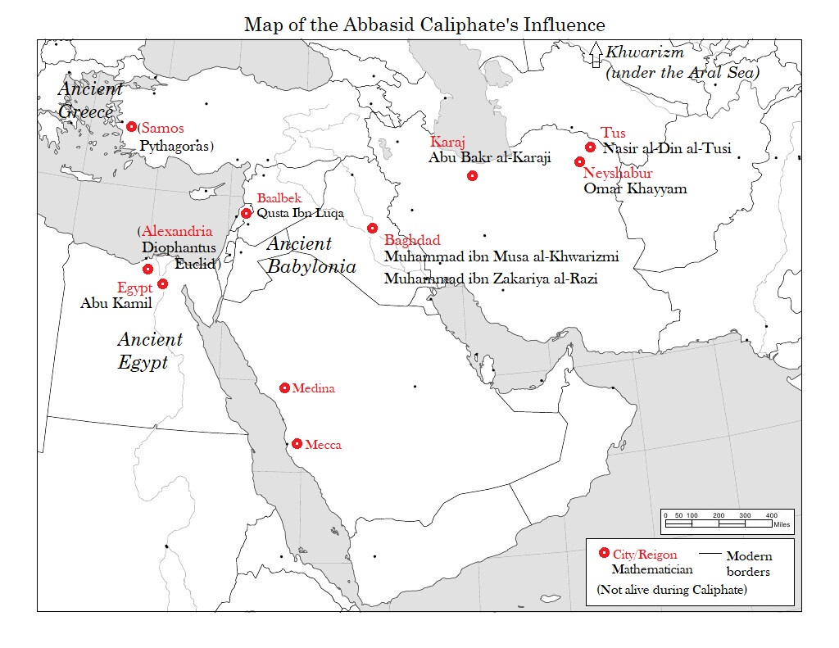

Slide 15
House of Wisdom
Al-Rashid was seen as a patron of learning who united all these scholars under a singular government and common language of Arabic.
Formal function a dispute amongst historians due to contents being destroyed in the Siege of Baghdad.
Certain that it was home to an extensive private library belonging to al-Rashid and expanded into a public institute under half brother Abu al-Abbas Abdullah

Slide 16
Perfect conditions for the House of Wisdom
Religious Influence
Hadiths that place values on education and acquiring knowledge.
Government sponsorship
Patronized scholars. Money spent on translations estimated to be twice the UK Medical Research Budget.
Diverse contributions
New technology:
Easier writing systems.
Paper.

Slide 17
Tolerance and diversity
Formed on the Islamic principles through various Quaranic injunctions and Hadith (stories of the prophet).
Showed a strong interest in assimilating knowledge outside of their heritage, extending this inclusivity to theology.
Mohammed ibn Zakariya al-Razi (865-925), more commonly known by his Latinized name Rhazes, was a notable polymath of the Islamic Golden Age who wrote:
‘Books on medicine, geometry, astronomy, and logic are more useful than the Bible and the Qur’an. The authors of these books have found the facts and truths by their own intelligence without the help of prophets.’

Slide 18
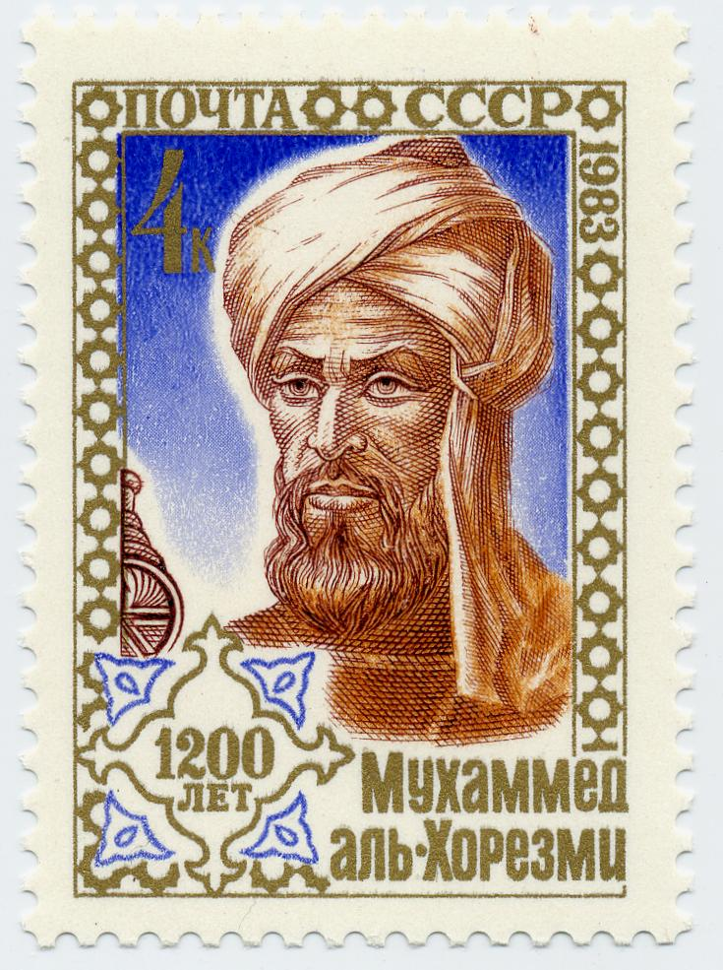
Al-Khwarizmi
Abu Abdallah Muhammad Ibn Musa al-Khwarizmi (780-850)
825 – On the Calculations with Hindu Numerals
830 – The Abridged Book on Calculation by Restoration and Completion
al -Kitāb al-Mukhtaṣar fī Ḥisāb al-Jabr wal-Muqābalah
“What is easiest and most useful in arithmetic such as men constantly requiring cases of inheritance, legacies, partition, lawsuits and trade and in all their dealings with one another or where the measuring of lands the digging of canals geometric computations other objects of various sorts and kinds are concerned”

Slide 19
Al-Jabr and algebra
We see how ‘algebra’ is derived from ‘al-jabr’.
There are several literal translations of the title of the treatise (concerning al-jabr (in Arabic script 'الجبر') and al-Muqabala (in Arabic script 'المقابله’).
The former (completion or restoration), which was also used in English for a time for the setting of a broken bone, denotes the transference of a negative quantity from one side of the equation to the other.
The latter (balancing or opposition) as the adding of the same term on the same side.
His work is split into three parts:
An exposition on the rules for solving equations, followed by 40 sample problems.
A section on mensuration.
Practical uses of the Islamic rules of inheritance.

Slide 20
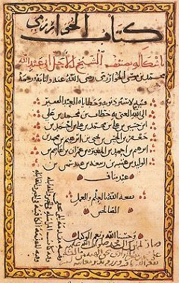
Classification on Linear and Quadratic Equations
The treatise begins with a brief outline of the decimal numbering system and then in six chapters presents the six types of equations which illustrate the elementary operations in which linear and quadratic equations are handled. It is important to note, however, that only positive numbers were considered true solutions to equations. The six types, with modern notations, are:
squares equal roots (ax² = bx)
squares equal number (ax² = c)
roots equal number (bx = c)
squares and roots equal number (ax² + bx = c)
squares and number equal roots (ax² + c = bx)
roots and number equal squares (bx + c = ax²)

Slide 21
Translations and expansions
1145 - Robert of Chester, Englishman
- Gerard of Cremona, Italian
1228 – Fibonnaci: Liber Abbaci
First reference of the term “Algebrae” yet only a singular reference to Al-Khwarizmi’s first name.

Slide 22
Cubic and the Algebraic Beyond
Al-Karaji, Omar Khayyam – work on the cubic, proof by induction.
Abu Kamil was the first to accept irrational solutions and refined the concept of numbers.
Italian mathematicians added numerical solutions for cubic and biquadratic equations.
Gradually developed into the study of the character of the roots.
Decartes introduced mathematical notation.
Girard and Descartes concluded that an equation of n degree can have no more than n roots.
Fundamental theorem of algebra proven by Gauss in 1799.

Slide 23
Introspective Look at Academia
Misconceptions of mathematics and culture.
Why is a history that has barely been shaped in Europe presented like it has?
Diversity within the works and within the academy.
How have our questions been answered?
How do we change the narrative?

Slide 24
Thank you.

