Slide 1
Organic Named Reactions and Social Challenges
The Role of British and European Women Organic Chemists before, during and after WWI

Slide 2
Aims of this work
My work was initially focused on named reactions. I realised very few were named after women.
My hypothesis is that this is due discrimination against female chemists in the first half of the 20th century and that it does not only originate in the organic chemistry community. There were very few women in the field due to the historical context in which they lived.
The following historical explanations and case studies support my theory by showing the obstacles women faced to become successful chemists in society. While some are strictly related to organic named reactions, others are not.
Another aim is to celebrate women in chemistry, their strengths and show how they could inspire present and future generations of chemists.

Slide 3
Contents
Background Knowledge of Named Reactions
Women’s Education in the late 19th and early 20th Century
Women as Researchers and Academics in Man’s World
The Great War and Social Changes

Slide 4
Case Studies
Martha Annie Whiteley
Irma Goldberg
Gertrude Maud Robinson
Edith Hilda Ingold

Slide 5
Background Knowledge of Named Reactions
Reactions named after existing people.
They are mostly unregulated and influenced by scientific community.
They have strong mnemonic value, carry a lot of information in few words.
Very few women were included in the naming process, understanding the reason is crucial.
Notes:
Consider talking about:
Matter
Phase
Bonding
Energy
Reaction
Ions and salts
Acidity and basicity
Redox
Equilibrium
Chemical laws

Slide 6
An Example: the Wittig Reaction
Reaction of a triphenyl phosphonium ylide with a ketone

Slide 7
An Example: The Diels-Alder
Reaction of a substituted alkene and a conjugated diene

Slide 8
Women’s Education in the late 19th and early 20th Century
Wealthy daughters were mostly educated at home in a sheltered environment, where they studied “feminine subjects” such as painting and singing. Exceptions did exist.
At university in Germany the Abitur was often an insurmountable obstacle, in Italy applications could be rejected on the bases of gender, only some institutes allowed French women.
In Great Britain elite universities allowed women to graduate in 1920 (Oxford) and in 1948 (Cambridge).
Notes:
Consider talking about:
Of definition
Of discipline

Slide 9
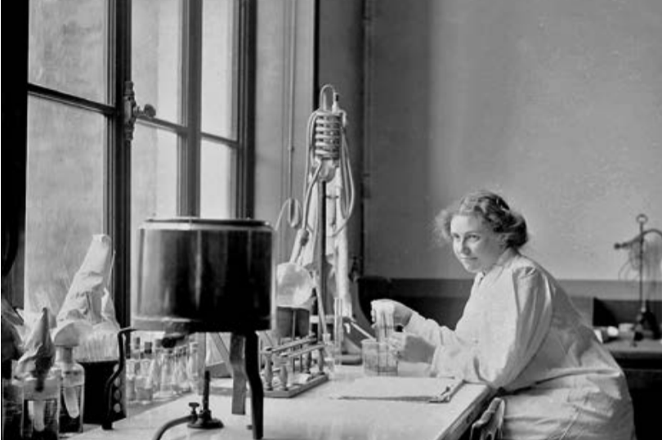
Women at the Pasteur Institute (France) in 1919 and 1912

Slide 10
Women as Researchers and Academics in Man’s World
Women often worked as assistants, earning low salaries or for free. Only wealthy ones could work in research or academia.
They were often overshadowed by male collaborators, who were preferred solely on gender.
They were excluded from many learned societies for years, examples being the Linnean Society (1904), The German Chemical Society (1910), The Chemical Society (1920).
Notes:
Consider talking about:
Subdisciplines
Industry

Slide 11
Martha Annie Whiteley
She was born in 1866, obtaining a BSc in Chemistry in 1890 and a doctoral degree in 1902 from Royal Holloway College.
She worked at the Royal College of Science, although kept her job as a teacher to have a full salary.
Martha founded there the Imperial College Women’s Association and improved cloakroom facilities for women.
She studied oximes, their tautomerism and barbiturates.
She participated in the war efforts, creating tear gases and incendiary mixtures (DW being an example).
Martha co-authored editions of the Thorpe’s Dictionary of Applied Chemistry.
Notes:
Consider talking about:
Subdisciplines
Industry

Slide 12
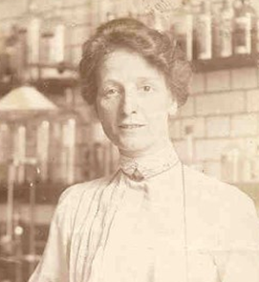
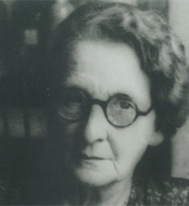
Pictures of Dr Whiteley

Slide 13
Martha Annie Whiteley
She did not work on named reactions but is a good example to describe discrimination against women before WWI.
She fought discrimination against women, which showed in the denied access to The Chemical Society.
Martha signed a petition in 1904 and a letter on Nature in 1909. Both were rejected, due to strong opposition by men like Henry Armstrong.
Women were only admitted after the approval of the Sex Disqualification Removal Act in 1919.
Notes:
Consider talking about:
Subdisciplines
Industry

Slide 14
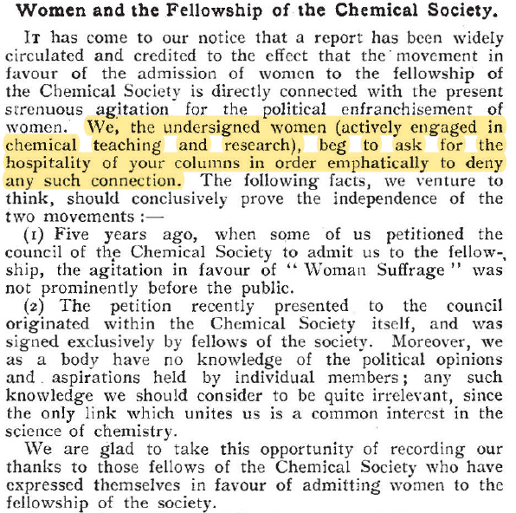
The 1909 Letter to The Chemical Society

Slide 15
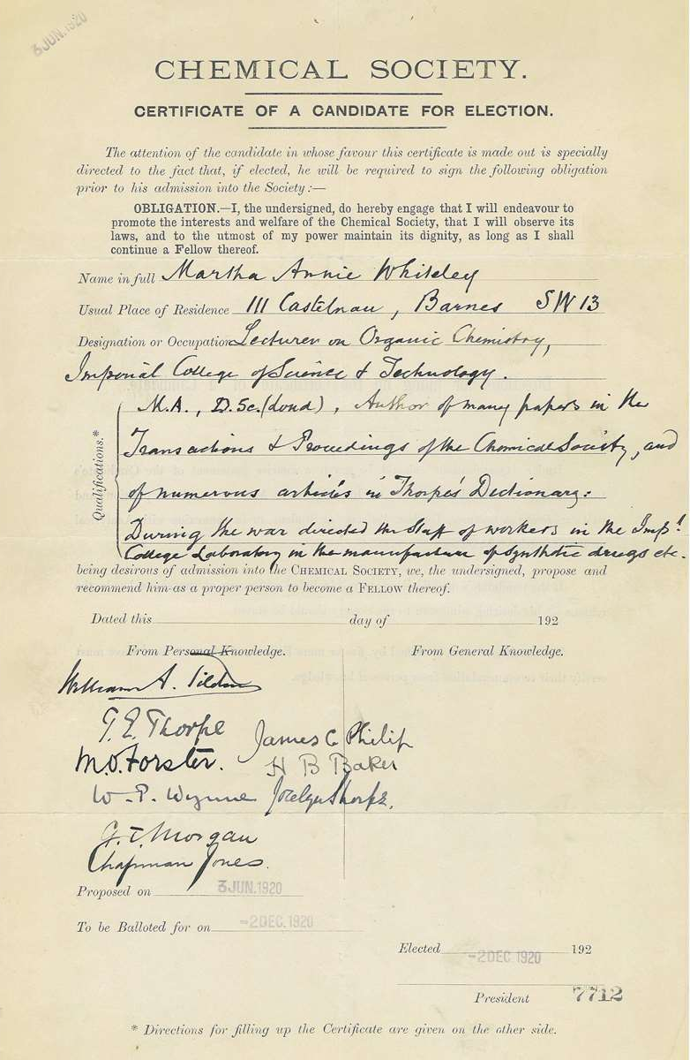
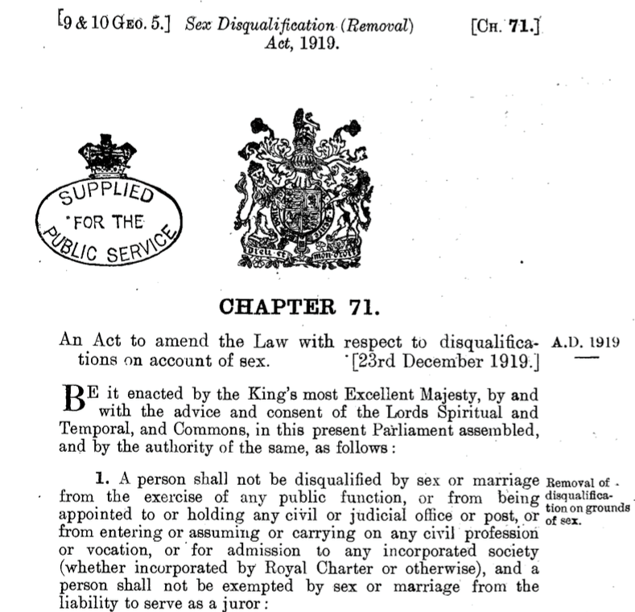

Slide 16
Irma Goldberg
She was born in Moscow in 1871.
She studied in Switzerland, as many Russian girls used to do.
Irma worked as laboratory assistant and then Privatdozentin at Geneva in 1897, thus she started teaching.
She worked on the Goldberg and Jourdan-Ullman-Goldberg reactions in the years 1906-1908.
She married Ullmann in 1910 and worked on anthraquinone derivatives.
It is not known when she died but she was still alive in 1939, date of her husband’s death.
Notes:
Consider talking about:
Subdisciplines
Industry

Slide 17
The Goldberg Reaction
The Jourdan-Ullmann-Goldberg Reaction
Notice the use of a copper catalyst and potassium carbonate to improve the reaction yield

Slide 18
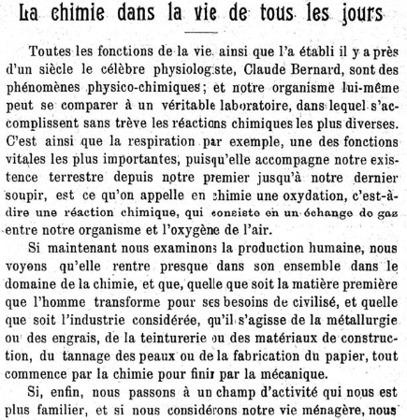
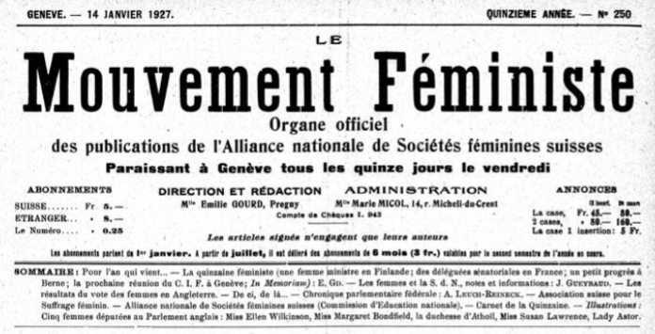

Slide 19
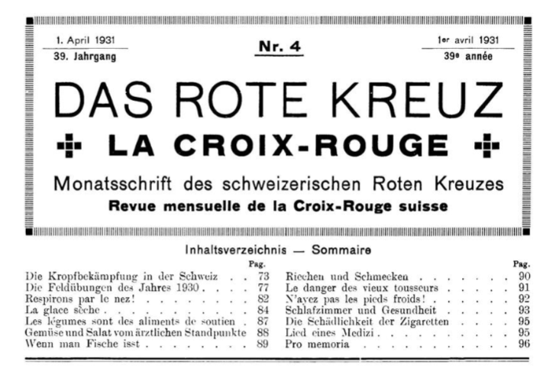
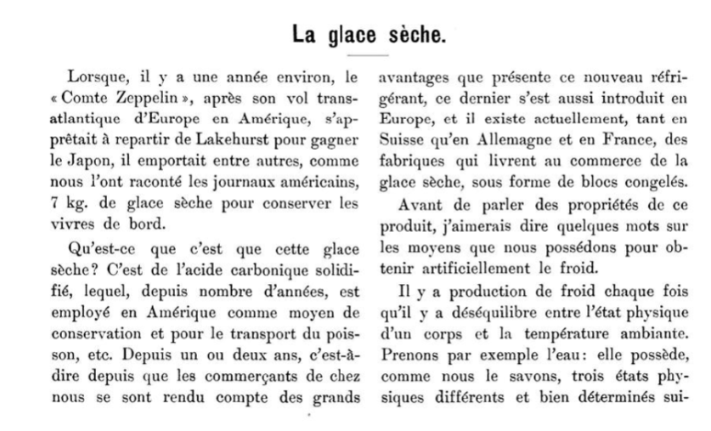

Slide 20
The Great War and Social Changes
Women took up an important part of the warfare effort. They mostly worked in factories.
Men often opposed women taking up their jobs.
They had lower salaries than men and often had to give up their jobs after WWI.
However, the war allowed women in science to stand out and have important positions in laboratories and academia.
Women were given the right to vote in some countries in Europe: examples are Germany, Poland, The Netherlands and partially Britain.
Notes:
Consider talking about:
Subdisciplines
Industry

Slide 21
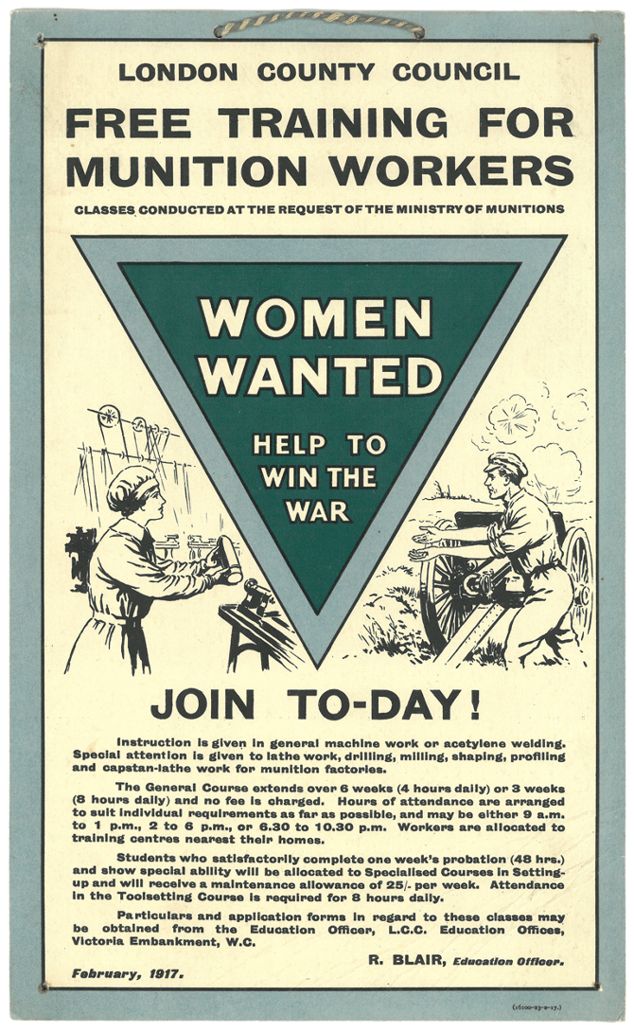
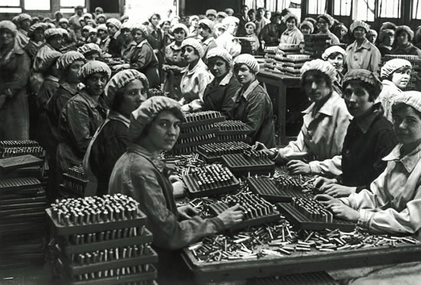

Slide 22
Gertrude Maud Robinson
Gertrude Maud Walsh was born in 1886. She got a B.Sc. and a M.Sc. degree at the Victoria University of Manchester.
She was a teacher and started working in research too. She met Robert Robinson, whom she married in 1912. They moved to Sidney, where Gertrude worked as an unpaid demonstrator.
As women were banned from the Sectional Dinner of the British Association for the Advancement of Science, she organised her own event in the same hotel.
She moved to Oxford when Robert became professor there, pursuing her organic chemistry research until her death in 1953. Gertrude had just obtained Honorary Degree of Master of Arts from the university.
Notes:
Consider talking about:
Subdisciplines
Industry

Slide 23
Gertrude contributed to the Piloty-Robinson Pyrrole synthesis with a paper published in 1918, which based its roots on a deep study on the Fischer Indole synthesis.
An example of Fischer Indole Synthesis
Piloty-Robinson Pyrrole Synthesis

Slide 24
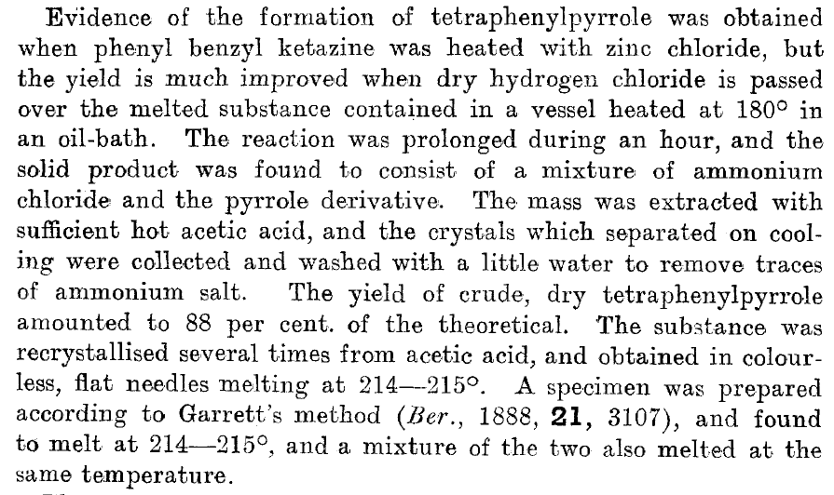
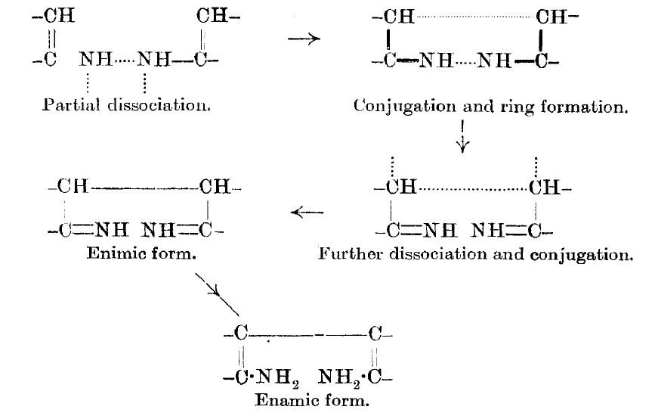

Slide 25
Studies on plant pigments and other research topics
Gertrude was a pioneered in the study of fatty acids, synthesising oleic acid and higher acids.
She worked with her husband on plant pigments,. Robert got the Nobel Prize for his research while she did not.
Gertrude was recognised in her husband’s Nobel lecture:
“Though it might be invidious to mention individuals, yet I may be allowed to say how much I owe to the constant help of my wife, not quite my first, but my most consistent collaborator, and over the longest period of years.”

Slide 26
Edith Hilda Ingold
Edith Hilda Usherwood was born in 1898, her father was an engineer.
She gained a Ph.D. at Imperial College under Dr Whiteley’s supervision, working on tautomerism of oximes..
Hilda worked with Ingold on “The specific heats of gases with special reference to hydrogen”, applying energy levels to C_{V} of diatomic molecules. They married in 1923.
She participated in the Robinson-Ingold controversy about the electronic theory. She worked for 72 hours with no break in the laboratory to fix her errors.
During WWII Hilda got a paid position as a secretary. She abandoned her role as researcher, becoming a more typical professor’s wife.
Notes:
Consider talking about:
Subdisciplines
Industry

Slide 27
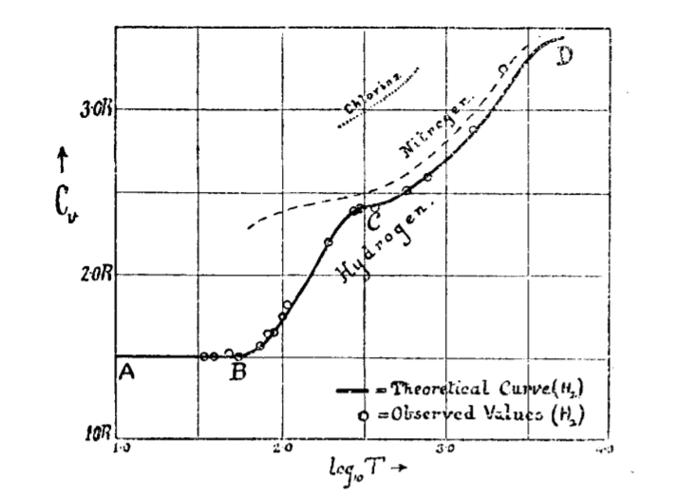
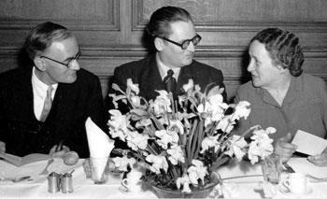
The diagram from the 1922 paper on C_{V}, showing theoretical and experimental data
Christopher Ingold, Hughes and Hilda Ingold

Slide 28
Conclusion

Slide 29
Works cited
Krietsch Boerner, Leigh. “Podcast: Chemists Debate the Value of Name Reactions in Organic Chemistry.” C&amp;EN, 2020. https://cen.acs.org/synthesis/reaction-mechanisms/Podcast-Chemists-debate-value-name-reactions-in-organic-chemistry/98/web/2020/08.
Krauch, Helmut., and Werner Kunz. Foreword to “Organic Name Reactions : A Contribution to the Terminology of Organic Chemistry, Biochemistry and Theoretical Organic Chemistry”. New York: Wiley, 1964.
Drahl, Carmen. “In Names, History and Legacy” Chem. Eng. News 2010, 88 (20), 31–33. https://cen.acs.org/articles/88/i20/Names-History-Legacy.html
Morris, Peter J. “Named Reactions - Forgotten Chemists.” Chem. Ind. 24, 1999: 968–72.
Dyhouse, Carol. Girls Growing up in Late Victorian and Edwardian England. Routledge Library Editions. Women's History ; v. 14. London: Routledge, 2013: 3-39
Mazón, Patricia M. Gender and the Modern Research University : The Admission of Women to German Higher Education, 1865-1914. Stanford, Calif.: Stanford University Press, 2003.
“HISTOIRE.” HISTOIRE - Institut Pasteur, 1997-2015. https://phototheque.pasteur.fr/fr/navigation/list/WS/HOME_MENU/node/5/slug/histoire/nobc/1
Piattelli, Valentina. “Breve storia dell'emancipazione Femminile in Italia.” la Repubblica, n.d. http://www.storiaxxisecolo.it/larepubblica/repubblicadonne.htm
“The Great Scheme.” Girton College, n.d. https://www.girton.cam.ac.uk/pioneering-history/the-great-scheme

Slide 30
Works cited
Rayner-Canham, Marelene F, and Rayner-Canham, Geoffrey. “Chemistry Was Their Life: Pioneer British Women Chemists, 1880-1949.” London: Imperial College Press, 2008: 62-79, 215-260, 421-446.
Dyhouse, Carol. No Distinction of Sex? : Women in British Universities, 1870-1939. Women's History. London, [England]; New York, 2016: 189-237.
Jones, Claire. "Careers and Controversy before the First World War." Nature, London; 575, no. 7781, 2019: 239-42.
Remenyi, Christian. "Einhundertundfünfzig: Die Zahlenstatistik Zum Jubiläumsjahr." Nachrichten Aus Der Chemie: Zeitschrift Der Gesellschaft Deutscher Chemiker 65, no. 1 , 2017: 46.
Knapp, Sandra. “Celebrating the First Women Fellows of the Linnean Society of London.” The Linnean Society, 2018.https://www.linnean.org/news/2018/03/20/20th-february-2018-celebrating-the-first-women-fellows-of-the-linnean-society-of-london.
Apotheker, Jan., and Sarkadi, Livia Simon. “European Women in Chemistry”. Weinheim: Wiley-VCH Verlag GmbH & KGaA, 2011: 31-34.
Rayner-Canham, Marelene F, and Rayner-Canham, Geoffrey. “POUNDING ON THE DOORS: THE FIGHT FOR ACCEPTANCE OF BRITISH WOMEN CHEMISTS.” Sir Wilfred Grenfell College. Bull. Hist. Chem 28, no. 2 (2003): 110–19.
Whiteley , Martha A., Smedley, Ilda and others “Women and the Fellowship of the Chemical Society.” Nature, 1909,399.
“Sex Disqualification (Removal) Act.” UK Parliament, n.d. https://www.parliament.uk/about/living-heritage/transformingsociety/tradeindustry/industrycommunity/collections/sex-disqualification-removal-act/sex-disqualification-removal-act/.

Slide 31
Works cited
“Women's Emancipation Bill” UK Parliament, n.d. https://www.parliament.uk/about/living-heritage/transformingsociety/tradeindustry/industrycommunity/collections/sex-disqualification-removal-act/womens-emancipation-bill/
Creese, Mary R. S., and Creese, Thomas M. Ladies in the Laboratory II : West European Women in Science, 1800-1900 : A Survey of Their Contributions to Research. Ebook Central. Lanham, Maryland, 2004: 303-304.
Burchardt, Anja. Blaustrumpf, Modestudentin, Anarchistin?: deutsche und russische Medizinstudentinnen in Berli 1896-1918. Stuttgart: Metzler, 1997.
Goldberg, I. Phenylationwith Presence of Copper as Catalyst.Chem. Ber. 1906,39, 1691–1692.
Goldberg, I.; Nimerovsky, M. Triphenylamine and Triphenylaminecarboxylic Acid. Chem. Ber. 1907, 40, 2448–2452.
Goldberg, I. Phenylation of Primary Aromatic Amines. Chem. Ber. 1908, 40, 4541–4546.
Irma, Ullmann-Goldberg. “La Chimie Dans La Vie De Tous Les Jours.” Le mouvement féministe : organe officiel des publications de l'Alliance nationale des sociétés féminines suisses 251, 1927: 10–11.
Irma, Ullmann-Goldberg. “La Glace Sèche.” Das Rote Kreuz : offizielles Organ des Schweizerischen Centralvereins vom Roten Kreuz, des Schweiz. Militärsanitätsvereins und des Samariterbundes 4, 1931: 84–86.
Fara, Patricia. A Lab of One's Own : Science and Suffrage in the First World War. First ed. Oxford, 2018: 115-196, 265-286.

Slide 32
Works cited
“Sir Robert Robinson.” Magdalen College Oxford., n.d. https://www.magd.ox.ac.uk/discover-magdalen/history-of-college/famous-alumni/sir-robert-robinson/
Lykknes, Annette, Donald L Opitz, and Brigitte Van Tiggelen. “The Mystery of the Nobel Laureate and His Vanishing Wife .” Chapter 4 in “For Better or for Worse?: Collaborative Couples in the Sciences”. Basel, Switzerland: Birkhäuser, 2012.
Robinson, Robert. Some Polycyclic Natural Products: Nobel Lecture, December 12, 1947. Stockholm, 1949.
Robinson, Robert. Memoirs of a Minor Prophet: 70 Years of Organic Chemistry. Amsterdam ; New York: Elsevier, 1976: 55-56.
Robinson, Gertrude Maud, and Robinson, Robert. "C.—The Mechanism of E. Fischer's Synthesis of Indoles. Application of the Method to the Preparation of a Pyrindole Derivative." J. Chem. Soc., Trans 125, 1924: 827-40.
Robinson, Gertrude Maud, and Robinson, Robert. "LIV.—A New Synthesis of Tetraphenylpyrrole." J. Chem. Soc., Trans 113, 1918: 639-45.
Lawrence, William John Cooper, Price, James Robert, Robinson, Gertrude Maud, and Robinson, Robert. "The Distribution of Anthocyanins in Flowers, Fruits and Leaves." Philosophical Transactions of the Royal Society of London. Series B, Biological Sciences 230, no. 567. 1939: 149-78. and others.
Synge, Richard Laurence Millington. "How the Robinsons Nearly Invented Partition Chromatography in 1934." Notes and Records of the Royal Society of London 46, no. 2, 1992: 309-11.

Slide 33
Works cited
Robinson, Gertrude Maud. "CCCXCVII.—Attempts to Find New Anti-malarials. Introduction by George Barger and Robert Robinson. Part I. Some Pyrroloquinoline Derivatives." Journal of the Chemical Society, 1929, 2947-951.
Dunstan, A. E, Woodhead, D. W, and Simonsen, J. L. "Obituary Notices: John Samuel Stafford Brame, 1871–1953; Colin Campbell, 1888–1953; Gertrude Maud Robinson, 1886–1954." Journal of the Chemical Society, 1954, 2664-668.
Brock, W. H. The Case of the Poisonous Socks : Tales from Chemistry. Cambridge: RSC Publishing, 2011: 218-230.
Ingold, Christopher Kelk, and Usherwood, Edith Hilda. "CCLXXVI.—The Specific Heats of Gases with Special Reference to Hydrogen." J. Chem. Soc., Trans 121, 1922: 2286-291.
Saltzman, Martin D. “The Robinson-Lngold Controversy: Precedence in the Electronic Theory of Organic Reactions.” Journal of Chemical Education 57, no. 7, 1980: 484–86.
Special mention to:
Olson, Julie A, and Shea, Kevin M. "Critical Perspective: Named Reactions Discovered and Developed by Women." Accounts of Chemical Research 44, no. 5, 2011: 311-21.
Olson, Julie A, and Shea, Kevin M. "Additions and Corrections to Critical Perspective: Named Reactions Discovered and Developed by Women." Accounts of Chemical Research 45, no. 3 (2012): 482-83.

